Slide 1
Creating Mobile Applications with jQuery Mobile and PhoneGap Build
Chris Griffith | Staff Engineer – Qualcomm Technology Inc.

Slide 2
Disclaimer
These opinions and thoughts are my own, and may or may not reflect the opinions of the company that I work for.

Slide 3


Creating Mobile Applications with jQuery Mobile and PhoneGap Build

Slide 4
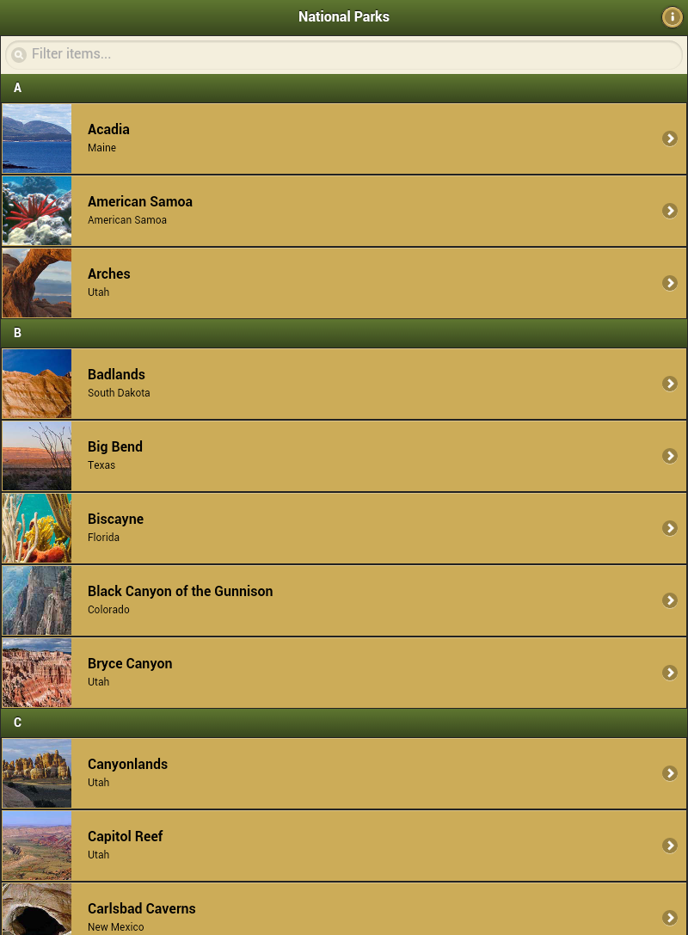
Creating Mobile Applications with jQuery Mobile and PhoneGap Build

Slide 5
Lab 7: Update
<section id="parkDetailsPage" data-role="page">
<header data-role="header" data-position="fixed" data-id="appHeader">
<h1>National Parks</h1>
<a href="#about" data-role="button" data-transition="fade" data-icon="info" data-iconpos="notext" class="ui-btn-right">About</a>
</header>
<div id="parkDetails" data-role="content">
<img src="../../img/headers/arches.jpg">
<h1>Arches</h1>
<h2>Utah</h2>
<h3>Created: February 26, 1919</h3>
<p>Park details</p>
</div>
</section>

Slide 6

JSON
JSON (JavaScript Object Notation) is a lightweight data-interchange format. It is easy for humans to read and write.
It is easy for machines to parse and generate.

Slide 7
JSON example
var npsdata = {"parks":
[
{
"id":"0",
"name": "Acadia",
"createDate": "February 26, 1919",
"lat": "44.35",
"lon": "-68.21",
"image": "acadia.jpg",
"state": "Maine",
"data": "Covering most of Mount Desert Island and other coastal islands, Acadia preserves the tallest mountain on the Atlantic coast, granite peaks, ocean shoreline, woodlands, and lakes. There are freshwater, estuary, forest, and intertidal habitats."
}
]};

Slide 8
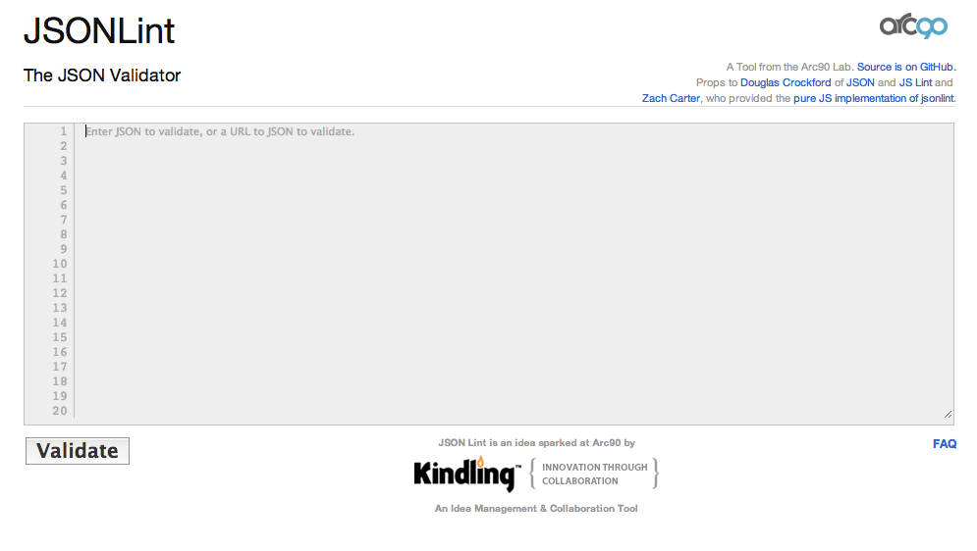
JSONLint

Slide 9
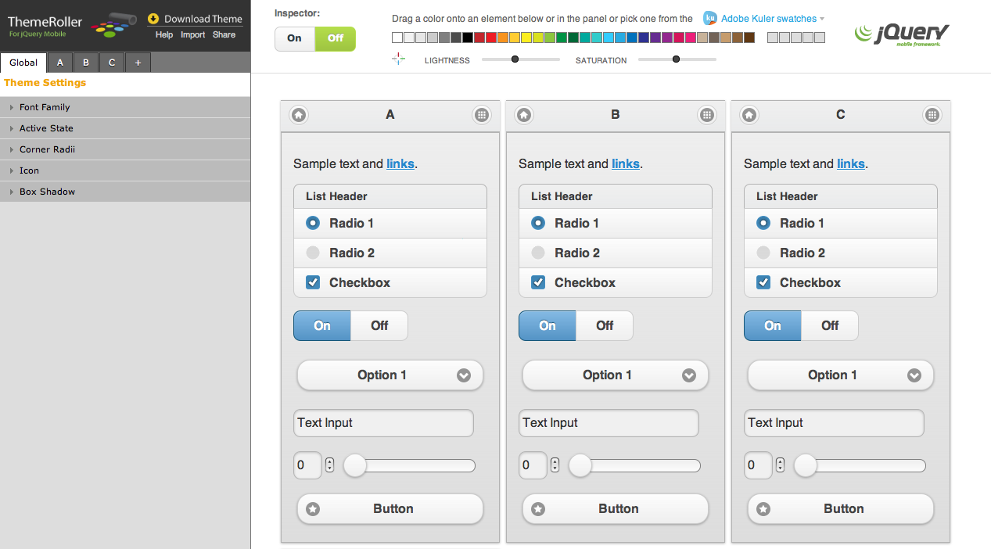
Theming Tools

Slide 10
Config.xml
<?xml version="1.0" encoding="UTF-8"?>
<widget xmlns = "http://www.w3.org/ns/widgets"
xmlns:gap = "http://phonegap.com/ns/1.0"
id = "com.adobemax.parkfinder"
versionCode=""
version = "1.0">
<name>Park Finder</name>
<description>A demonstration of jQuery Mobile and PhoneGap Build</description>
<author href="http://www.aj-software.com" email=chris.griffith@gmail.com>Chris Griffith</author>
<preference name="phonegap-version" value="2.2.0" />
<preference name="orientation" value="portrait" />
<preference name="target-device" value="universal" />
<preference name="fullscreen" value="false" />
<preference name="webviewbounce" value="true" />
<preference name="prerendered-icon" value="true" />
<preference name="stay-in-webview" value="true" />
<preference name="ios-statusbarstyle" value="black-opaque" />
<preference name="disable-cursor" value="true" />

Slide 11

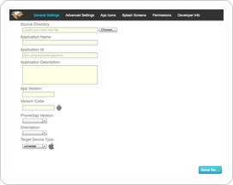
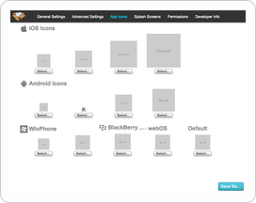
ConfiGAP
http://aj-software.com/configap/

Slide 12
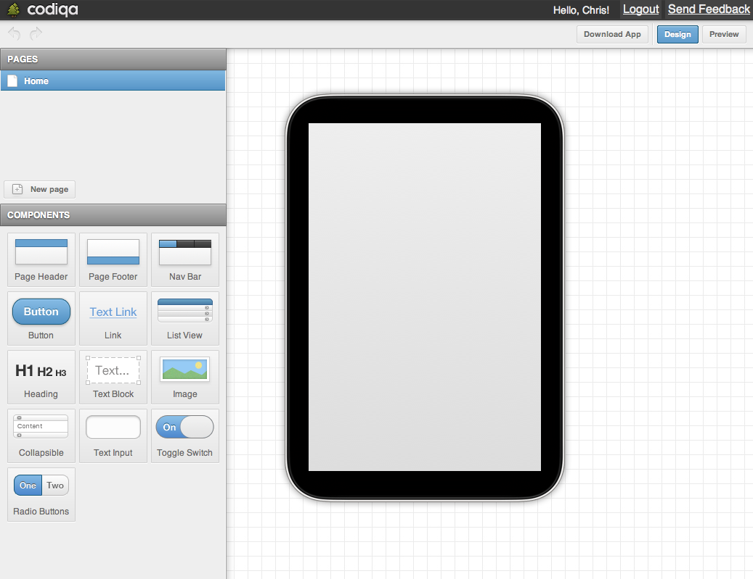
Codiqa
https://codiqa.com/

Slide 13


Books

Slide 14



Take the SESSION SURVEY on the MAX COMPANION app
…for your chance to WIN one of these e-books from Adobe Press
Every survey you submit enters your name to win the daily grand prize -
an Apple® iPod Nano®.

Slide 15




Contact Info
chris.griffith@gmail.com
@chrisgriffith
chrisgriffith.wordpress.com

Slide 16


